Slide 1
Role of TIOs in helping Pakistan develop better industrial development policies and practices
Dr. Safdar Sohail
Executive Director Social Protection Resource Centre, Islamabad
24.04.2025
Pakistan Institute of Trade and Development, Islamabad

Slide 2
[POST WW II] EVOLVING FRAMEWORK OF ECONOMIC STATECRAFT AND PAKISTAN’S RESPONSES

Slide 3
Fundamental Notions
Diplomacy focuses on facilitating interstate communications. The Objectives and Goals given to the Trade Diplomats emanate from the Statecraft, particularly the historically developed ‘Economic Statecraft’. Statecraft of a country embodies a broader scope of activities that occurs at the international level
Trade is a traditional tool of Economic Statecraft; its effectiveness usually is proportionate to the ‘military and economic strength’ of a country. Its amplification by stronger countries forces smaller countries to adopt a defensive orientation in Trade Diplomacy with different policy tools
Enhancement of Trade in itself could be a goal of Statecraft with the help of traditional, Pre-Trump foreign commercial policy at bilateral, multilateral, plurilateral levels or a force-backed trade, investment and industrial policy

Slide 4
Mission and Charter of Ministry of Commerce
MISSION STATEMENT
Contributing to the national economy through trade liberalization and facilitation, improving export competitiveness and reducing cost of doing business. Aim to achieve higher market access for Pakistani products in existing markets as well as new markets with ultimate aim of improving quality of life of the people of Pakistan.
CHARTER OF THE MINISTRY
Under the Rules of Business 1973, Commerce Division is assigned the following functions:
1. Imports and exports across custom frontiers. 2. Export promotion 3. Commercial intelligence and statistics 4. Tariff policy and its implementation 5. Anti-dumping duties, countervailing duties and safeguard laws. 6. Inter-Provincial trade 7. Domestic Commerce 8. Organization and control of Chambers and trade associations 9. Law of Insurance and regulation and control of Insurance companies 10. Administrative Control of Attached Departments/Organizations 11. Selection of Trade Officers for posting in Pakistan’s Missions abroad

Slide 5
Trade and Investment Diplomacy Infrastructure of MOC
Ministry of Commerce has developed a network of overseas Commercial Sections to protect Pakistan’s trade interests abroad, to facilitate the business community and advance their commercial interests on sustainable basis on which the socio-economic wellbeing of the country largely depends. The network consists of fully functional Commercial Sections in six continents equipped in men and material and headed by the highly professional civil servants skilled in the art of negotiation and trade diplomacy, thus advancing the commercial interest of the country in their respective post countries. Long Term Goals: Diversification of Products and Markets.

Slide 6
Conceptualization of Trade Diplomacy in India
The long-term vision of the Department is to make India a major player in the world trade and assume a role of leadership in the international trade. [Department of Commerce website]
‘’While introducing Economic Reforms in 1991, there was recognition that reforms were imperative if India wanted to become an economic power of consequence within and beyond the region. Official pronouncement reflected the concern that the balance of fiscal power as opposed to the military power was the key factor in determining a country’s international standing, calling for an integrated strategy to bring economic and foreign policies together.’’ [Sridharan 2002]

Slide 7
BACK TO THE BASICS

Slide 8
What is Statecraft?
In a world divided into sovereign nations, a country needs to practice Statecraft, broadly called Foreign Policy to pursue an International Political Economy. Statecraft is pursued through four primary instruments: information (words and propaganda), diplomacy (negotiations and deals), force (weapons and violence), and economics (goods and money)
[Lasswal, 1958]

Slide 9
What is Economic Statecraft?
Economic statecraft encompasses efforts by governments to influence other actors in the international system, relying primarily on resources that have “a reasonable semblance of a market price in terms of money.” [Baldwin 1986] [Reference to money prices is intended to distinguish economic statecraft from other types of statecraft, such as military statecraft, which utilize nonpecuniary means of persuasion or coercion, while at the same time accommodating the broadest possible range of measures that could usefully be called economic]
American Use of ‘State/Economic’ and ‘Foreign Commercial’ Diplomacy in their Embassies

Slide 10
Evolution of Economic Statecraft since WW II to 2016
Economic Statecraft | Financial Statecraft
1. Trade, Privileges, Tariffs and Quotas 2. Trade Sanctions on States 3.Foreign Aid 4. Regional Trade Agreements | 1. Capital Flow Guarantees and Restrictions 2. Financial Sanctions on Non-State Actors 3. Underwriting Foreign Debt in a currency crisis 4. Currency Unions

Slide 11
New Financial Statecraft
Trade is not the only way in which nations interact with each other economically. Whereas influencing international trade flows has long been and continues to be an important political objective and tool, another form of international economic exchange has risen to a level of much greater macroeconomic significance and political concern over the past two decades. This is the purchase and sale of financial assets—such as bonds, stocks, and derivative contracts—across borders, an activity whose growth has vastly outpaced that of traditional trade. Nearly $2 trillion worth of currency now moves cross-border everyday, roughly 90 percent of which is accounted for by financial flows unrelated to trade in goods and services—a stunning inversion of the figures in 1970, when 90 percent of international transactions were accounted for by trade.
Financial statecraft comprises those aspects of economic statecraft that are directed at influencing capital flows. These efforts involve harnessing financial institutions to achieve certain foreign policy objectives.
[Steil & Littan, Financial Statecraft, 2008]

Slide 12
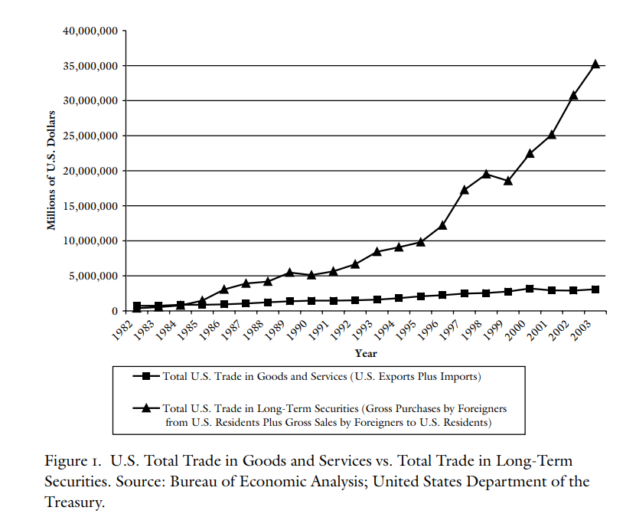
US Trade in Goods and Services vs Long Term Trade
Source: Benn Steil, & Litan, R. E. (2008). Financial statecraft : role of financial markets in American foreign policy. New Haven, Conn. ; London: Yale University Press.

Slide 13
Digital Diplomacy
Digital diplomacy refers to the impact of digital technology on diplomacy in three realms:
changing digital geopolitical and geo-economic environment for diplomatic activities (sovereignty, power redistribution, interdependence)
emerging digital topics on diplomatic agenda (e.g. cybersecurity, e-commerce, privacy protection)
new TOOLS for Economic Statecraft (e.g. social media, big data, AI)
      [https://www.diplomacy.edu/topics/digital-diplomacy]

Slide 14
New Great-Power Dynamics/Geo-economics
[Norloff 2021]
Key Theater: Financial Statecraft
Coercion
  Financial Sanctions
  Financial Crimes and Punishment
  Financial and Currency Deterrence
Financial Inducement
Subversive Inducement
Inducement complementing financial coercion
Combatting Defensive Counter-strategies
Retaliation
Financial Independence
Security Motivated decoupling

Slide 15
Use of expanded notion of Trade as a tool to advance Foreign Policy Goals: Ukraine Conflict as prelude to open tariff wars
Cyber is a stage for conflict
Energy Policy rotating towards source diversification
Food as a geostrategic tool
Splintered set of tech standards and policies
New Race for critical materials
New Age Supply Chain: Friends-shoring
Financial System effects
Rising Defense spending
Politicization of Corporates

Slide 16
Nexus between Economic Structure and Economic Statecraft in a globalized world: Need to reimagine growth and accumulation in Pakistan and re-articulate our ‘Industrial Development’

Slide 17
Economic Statecraft of the British Colonialism in India and its impact on the Economic Structure, its orientation and vulnerabilities
Key features of the role of the state in economic change in colonial India (1757- 1947):
Larger fiscal capacity [than the precolonial states] based on different foundations, such as centralization of finance and securitization of public debt
Eclectic, limited modernization of the economy due to the separation of debt from revenue operations
The colonial state however did not grow the fiscal capacity [by financing productive capacities of the economy, which they could tax], to enrich the Crown and in the process compromised public investment in infrastructure and social development. [Except raw material producing and transport investment in Canals]
Private Enterprises were served better, financed by ‘local’ banks, with low tech consumer items production growing organically with agriculture and population but dependent on British finished goods and chronic trade deficit, financed by ‘foreign debt’, from the Crown, intermediated by Colonial India’s Central Bank, established in 1936
Pakistan inherited Bazaars selling ‘Indian’-British products with little local production, [two local banks, no Central Bank], confounded by lack of cooperation from India, which developed its own Economic Statecraft against Pakistan very early. [Weaponizing Money share, water, military spares, spurning of currency]

Slide 18
Statecraft and Economic Structure: The case of Pakistan [Post 1947]
Peculiarity of Pakistan situation vis a vis India and China:
  Little economic and financial foundations
  Skeletal state structure and stretched state capacity
  Depletion of assets and HR due to emigration of Hindus and Sikhs
  Arrival of refugees, with enrepreneurship but little assets
The challenge in early years after 1947 was to produce an Economic Structure which could absorb old or recently unemployed and enterprises without assets
Choice was to go for a Free Market tilted mixed economy with import substitution as top priority vs socialist model of state led, autonomous industrialization
Emergence of Economic Statecraft Institutions to protect and grow the Economic Structure of the nascent state with help from Free World & Korean War
Discontent with Accumulation in late 1960s; greater role of state in industrialization of country; establishment of modern social security in 1970s

Slide 19
Wavering between two extremes: 1965 to 1985
Allocation of resources from State to the private sector, with aid and loans from the US, resulted in expanding the industrial base in the country but concentrated in fewer hands. With socialist government, inspired by China and Indian experience and learning from 1965 and 1971 wars, decided to strengthen Pakistan’s industrial base, establish social security institutions, expand mass education and health facilities and nationalized industry, banking and finance trusting the state to do a better job in terms of accumulation and distribution.
Reaction by the International Political Economy was swift and decisive. Though selected state-led heavy industrialization continued throughout 1980s, yet the Companies Ordinance,1984 and PERA 1992, adoption of structural adjustment reforms and accession to WTO marked a decisive shift.

Slide 20
Key Provisions of PERA 1992
The said Act was promulgated to strengthen the market economy, de-regularation and the liberalization process
The Act allows all the natural and legal persons to deal in foreign exchange in any form without making a foreign currency declaration and shall also be exempted from requisite taxation (Section 4)
Ensuring complete secrecy with respect to foreign currency transactions and bonafide banking transactions and no restrictions on deposits/withdrawals to be imposed (Section 5 and Section 9)
Fiscal incentives to be given to the investors (Section 6)
Section 7 and 8 bars the government from acquiring any privately owned entity putting a blanket bar on the nationalization process

Slide 21
Contemporary Pakistan
Though the uncritical acceptance of ‘global financial statecraft’ driven structural reforms in Pakistan [PERA 1992 to SBP Act 2021], had pernicious impact on our Economic Structure, reversing it is not easy as it attracts ire from the sustainers of Global Financial System.
We have demonstrated poor State Capacity in managing the recent past [real, fake, complex] strategic Vents of Growth i.e., War on Terror, ROZs, Trade with India, GSP Plus and CPEC
Still, Pakistan’s real economy has grown at an average of 7-8 % over the past 10, 12 years.
Trump is testing the limits of the weaponization of economic [tariffs, sanctions, trade restrictions], financial and cyber statecraft. This may create much needed additional policy space to protect our national interests in reforming our Economic Structure and allow our Trade Diplomats to help us find new Growth Vents in International trade of goods and services, in addition to their work on commercial diplomacy.
Should we pursue export-led and foreign investment protection industrial policies or we adopt a New Industrial Policy to enhance Pakistan’s manufacturing output and employment with Increased Manufacturing Value Added, Reduced manufactured per unit value, Greener and Leaner manufactured output, ending duality of domestic commerce and international trade, make LSM and financial sector serve DOMESTIC DEMAND.
Notes:
Given the unsustainable imbalances in the economy ---with no political party ready or interested to handle--- our diagnosis says that most of our problems were created because we made ourselves a dependent sub-set of some else’s Economic Statecraft. This could only change if we restore the practice of an autonomous Economic Statecraft of the state of Pakistan.

Slide 22
Approaches and Methodologies to protect and promote national economic statecraft
Better to start from ground and practice than from Theory:
Competitiveness [international, national, sectoral & Firm level]
Competition Policies [International, Sectoral, Firm level]
Growth and equity in a 3 sectors [agriculture, manufacturing and services] economy
Growth and distribution in a Market Civilization with Variety as an engine of growth
Post-productionist 21st century

Slide 23
Policy Scope & Vision of Draft New Industrial Policy [2025]
Objective: Create a market-driven, competitive economy.
Key Pillars:
  Export-led growth
  FDI attraction
  SME support
  Innovation & ESG compliance
What is new in it?

