Slide 1
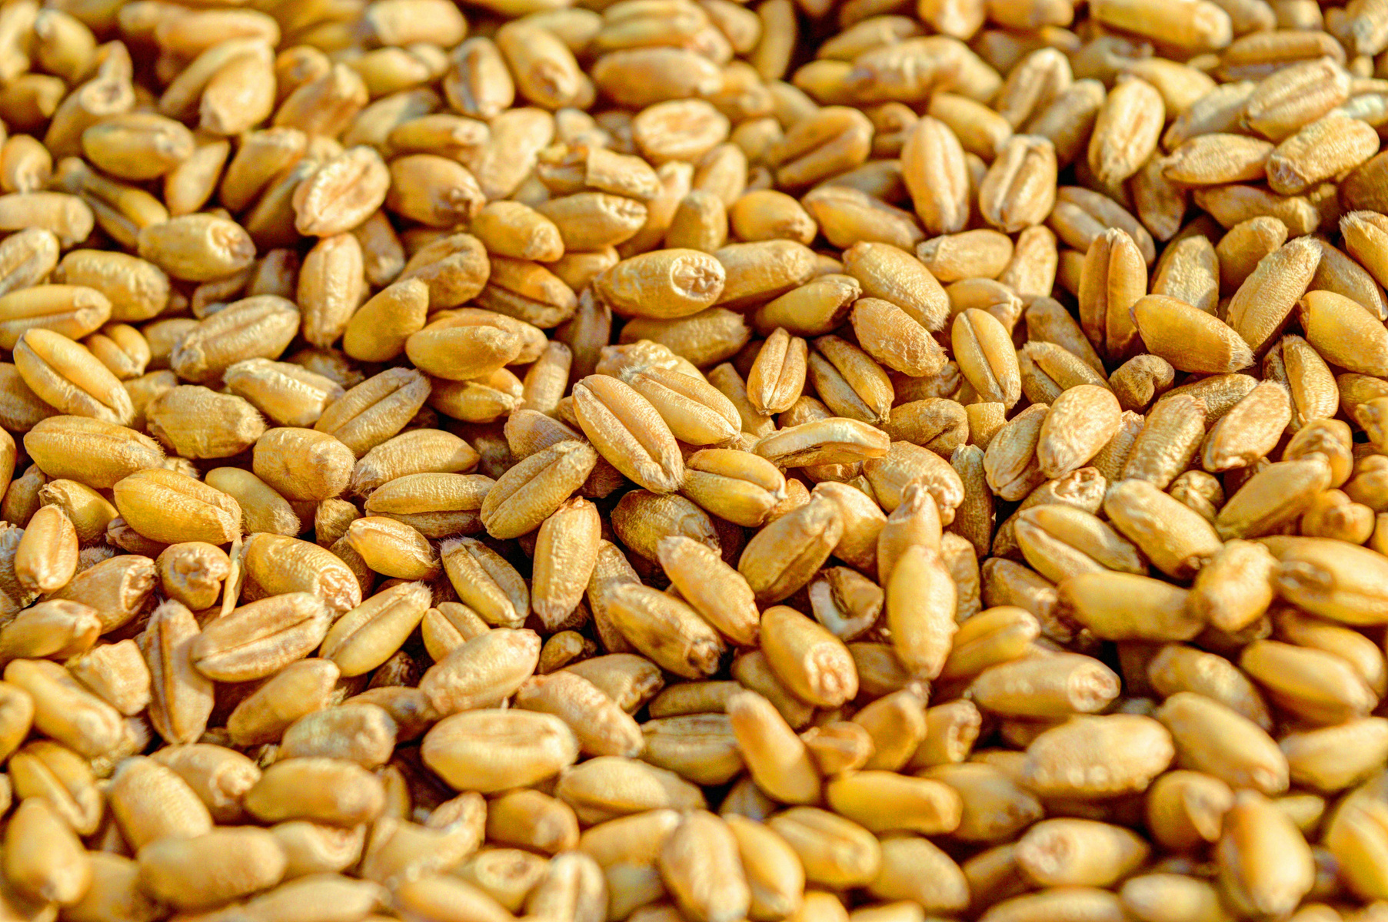



Food
Security
in a post-productivist
agricultural development
model in Pakistan
Dr.Safdar Sohail
19-August-2024
Website
www.reallygreatsite.com

Slide 2




Food Security - Pakistan
Despite food surplus, 36.9% of Pakistan's population faces food insecurity, primarily due to affordability issues (WFP 2018).
Pakistan ranks 99th out of 129 nations, with a declining score from 36.8 in 2000 to 26.1 in 2022.
Over 20% of the population is undernourished, and 45% of children under five are stunted (WFP).
Pakistani households spend 50.8% of their income on food, making them vulnerable to economic shocks
Key Drivers of Food Insecurity
High food prices (over 45% increase in 2023) and economic challenges.
Reduced income opportunities
Climatic shocks, including floods, heavy rains, and droughts.
Notes:
https://www.foodsystemsdashboard.org/

Slide 3
Introduction
Food is defined as a social good in our constitution - but it is being transformed to an ordinary commodity.
The withdrawal of the government from the Social Economy of Wheat is happening at a time, when our food security indicators are in a very bad shape. (Affordability of healthy diet, food inflation, household expenditure on food commodities)
State performed poorly in keeping in check unethical practices by economic actors who profit on food by resorting to the practices such as fraud, deception, coercion, exploitation of the needy, withholding supplies of essential goods and services.
Further Liberalizing and Financializing the production and exchange of Wheat and Atta can lead to serious social and political challenges.
The poor households are coping through child labour, crime, low quality jobs particularly for youth and women, starting micro-enterprises, household indebtedness, increase in begging and dependence on charity.
Hence, future planning and management of the Wheat and Flour in Pakistan needs to be situated in the unfolding Real Green Revolution at many places in the world, for meaningful ecological modernization.
Notes:
https://www.foodsystemsdashboard.org/

Slide 4

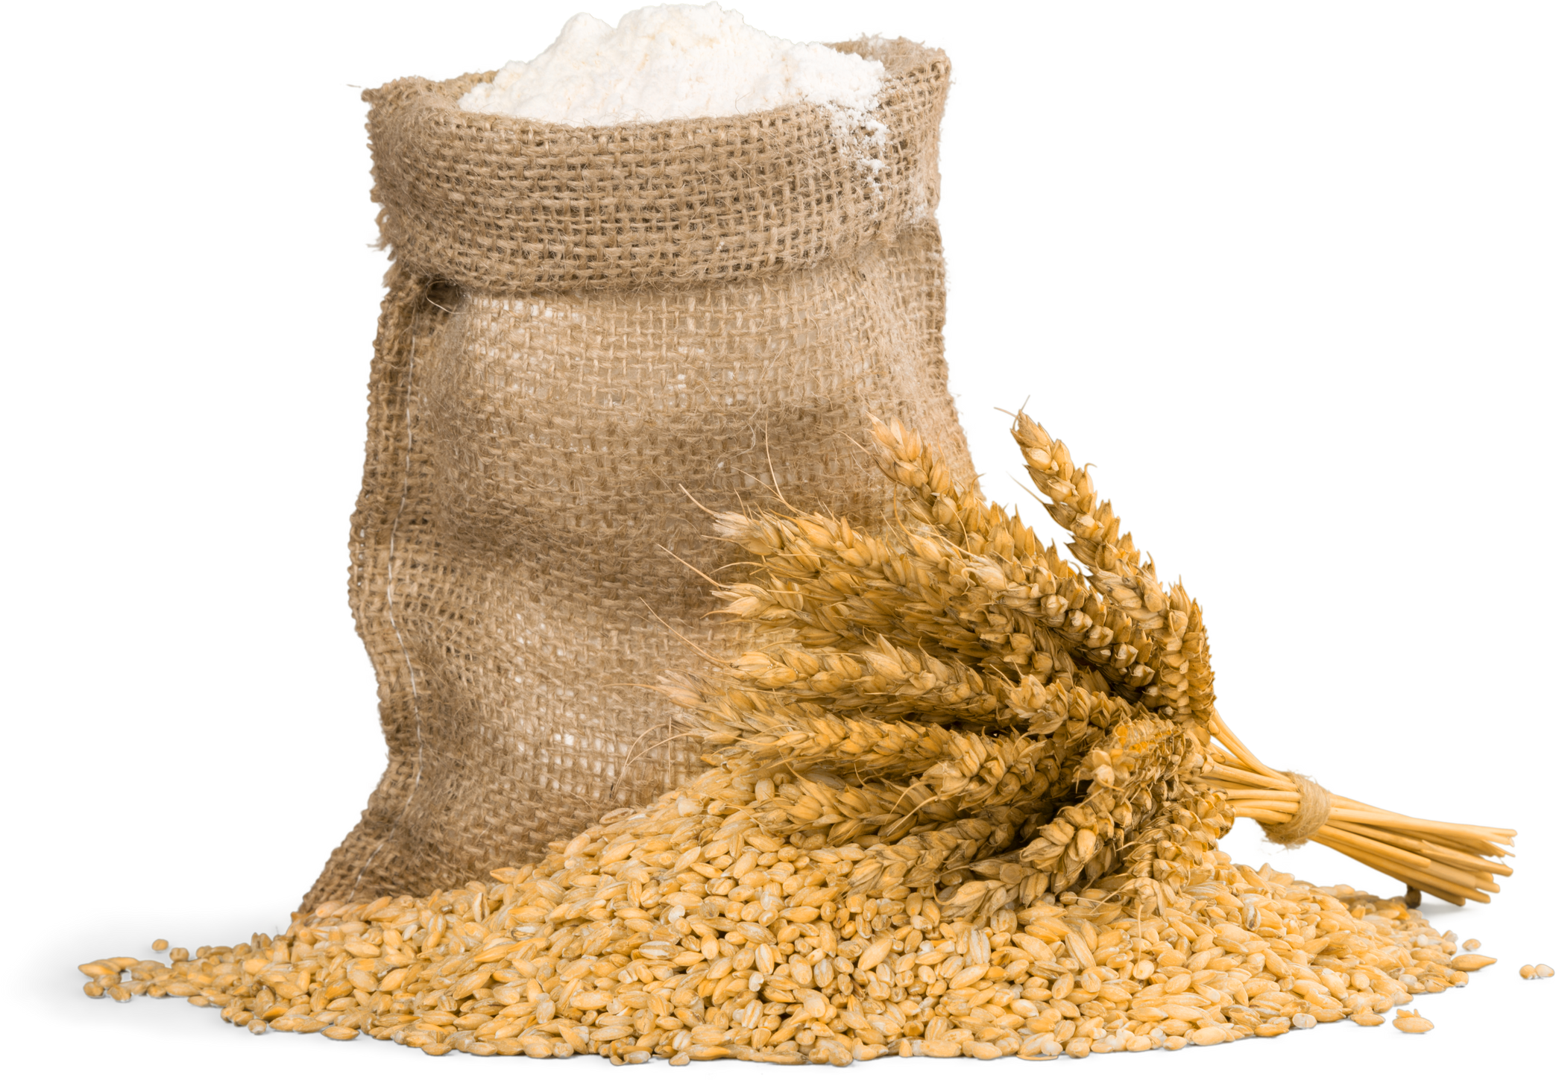
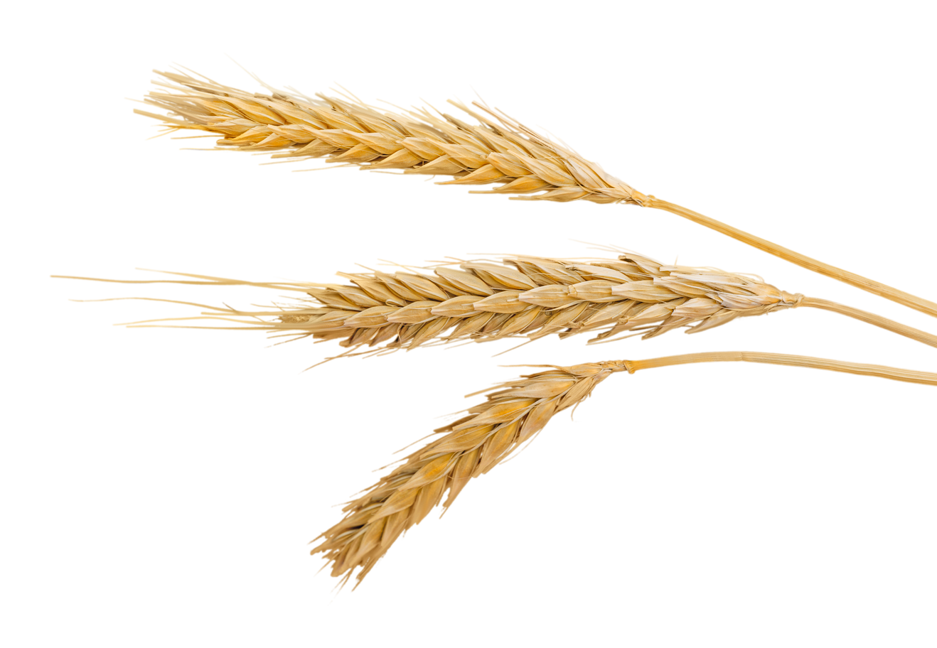
Food Security
& wheat economy Statistics
Website

Slide 5
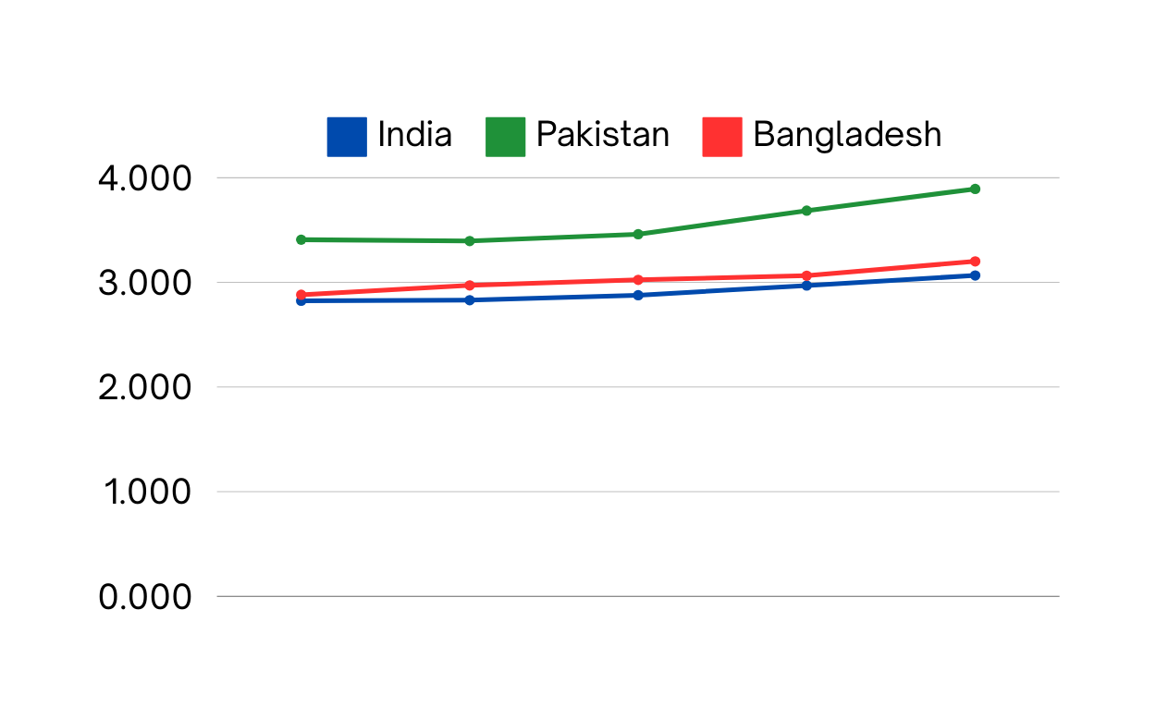
Cost of a Healthy Diet Per Capita (2017-2021 | USD PPP)
The cost of a healthy diet per capita across the three countries from 2017 to 2021
All three countries show an increasing trend, with Pakistan having the highest increase.
The cost of healthy diet per capita is higher in Pakistan (3. 89) compared to India (3.06) and Bangladesh (3.2)
Notes:
https://www.foodsystemsdashboard.org/

Slide 6

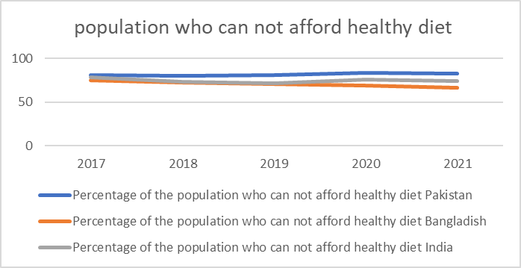

Population who cannot afford healthy diet
Pakistan
Pakistan: In 2021, 82.8% of people in Pakistan could not afford a healthy diet, an increase from 81% in 2017.
82.8%
Bangladesh
Bangladesh: In contrast, Bangladesh saw a decrease in this percentage from 75.3% in 2017 to 66.1% in 2021.
66.1%
India
India: India also experienced a decrease, from 78.8% in 2017 to 74.1% in 2021
74.1%
Notes:
https://www.foodsystemsdashboard.org/

Slide 7

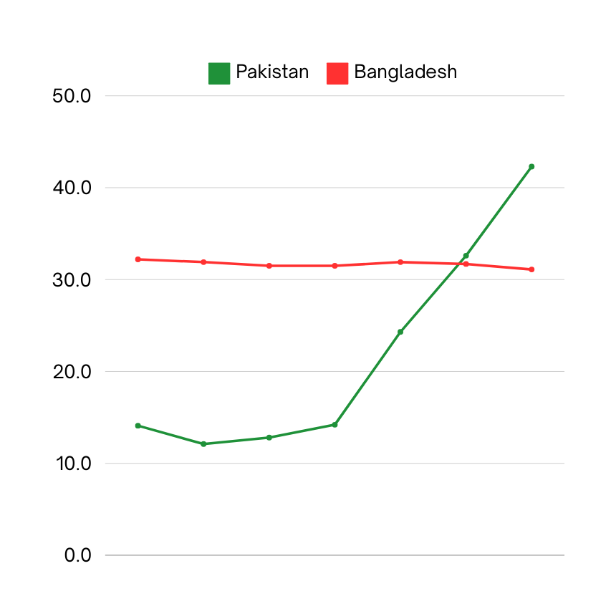
Prevalence of Food Insecurity
in Pakistan and Bangladesh (2015-2021)
Significant Increase: The prevalence of food insecurity in Pakistan increased sharply from 14.1% in 2015 to 42.3% in 2021.
In contrast, Bangladesh saw a decrease in food insecurity from 32.2% in 2015 to 31.1% in 2021.
Correlation with Rising Costs: This rise correlates with the increasing cost of a healthy diet and the high percentage of household expenditure on food
Impact of Inflation: CPI inflation in Pakistan is in double digits while in Bangladesh CPI inflation is in single digit.
Socio-economic impact: The data underscores the vulnerability of low-income groups in Pakistan to food price inflation, leading to increased food insecurity.
Notes:
https://www.foodsystemsdashboard.org/

Slide 8

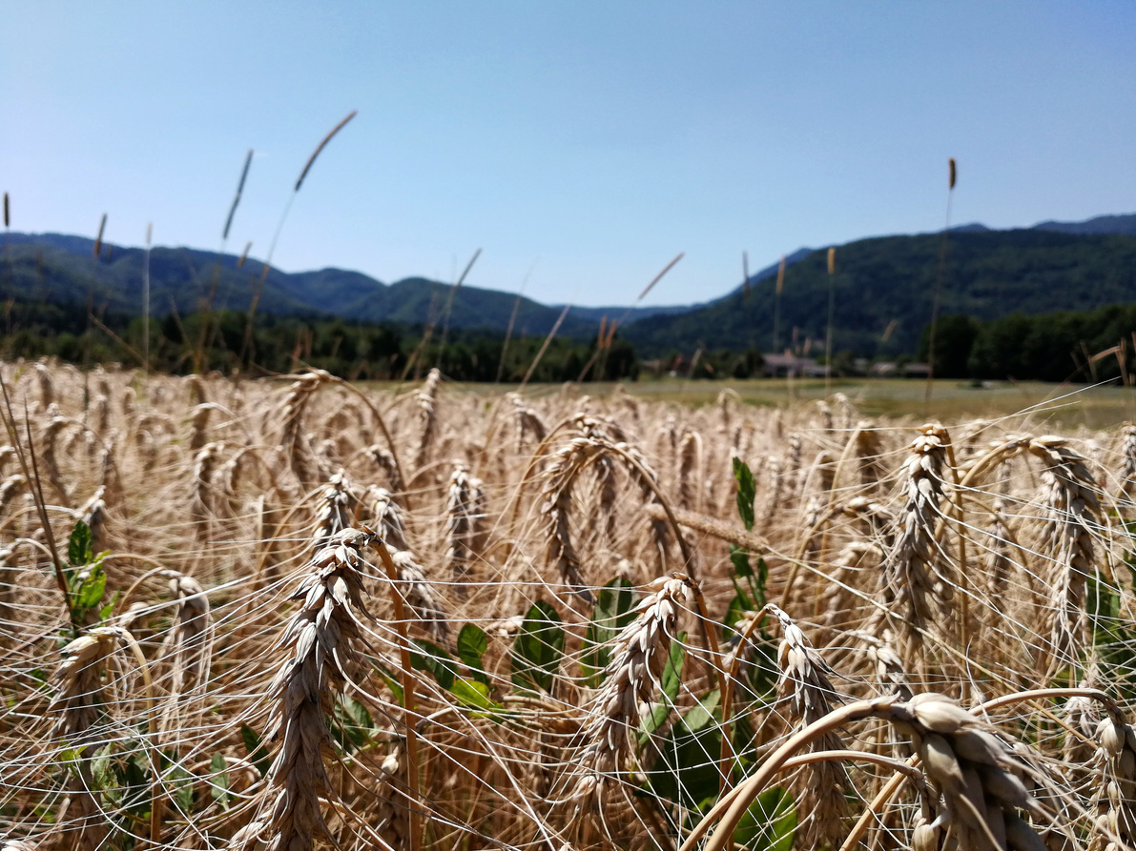


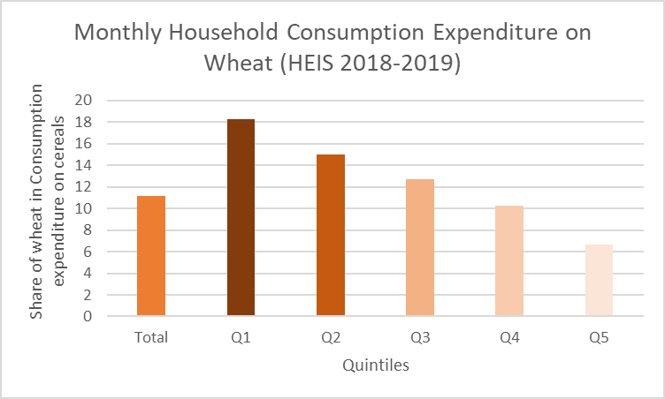
Monthly Household Consumption Expenditure by quantiles
On Wheat (HEIS 2018-2019)
Q1
Q2
Highest share, approximately 18%, on wheat, showing its importance in their diet.
Wheat accounts for about 15% of cereal expenditure.
Q3
Q4
Wheat expenditure is around 13%.
Households spend about 11%.
Q5
The wealthiest households spend the least on wheat, around 7%

Slide 9
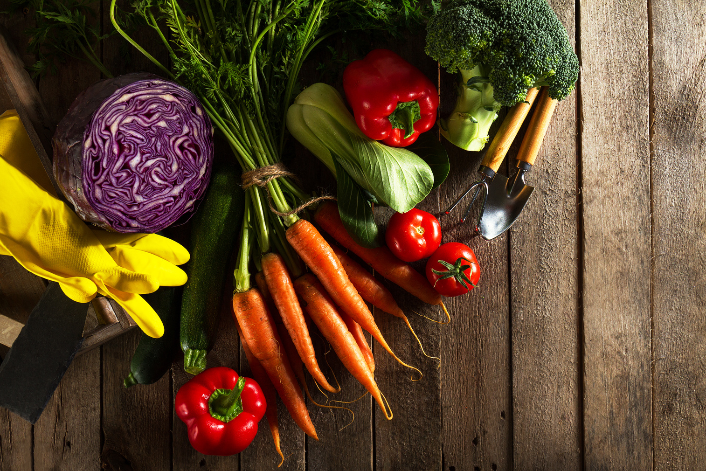
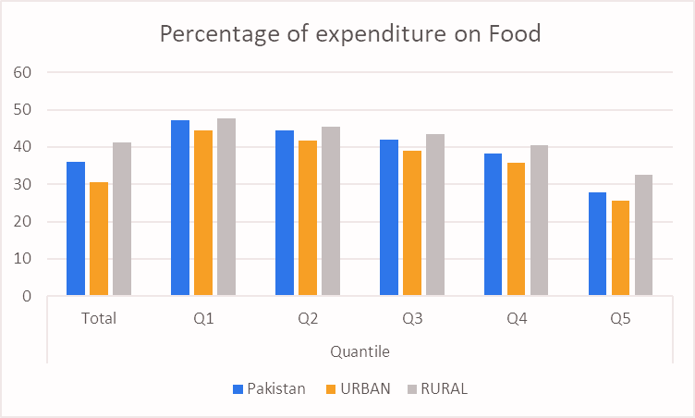
Monthly Household Consumption Expenditure by quantiles
Share of Food Commodities (HEIS 2018-2019)
Q1
Q2
Highest expenditure percentage on food, especially in rural areas (47.67%).
Urban: 41.66% | Rural: 45.32%
Q3
Q4
Urban: 38.94% | Rural: 43.38%
Urban: 35.65% | Rural: 40.5%
Q5
Lowest expenditure, indicating better economic resilience.
Urban: 25.65% | Rural: 32.56%

Slide 10
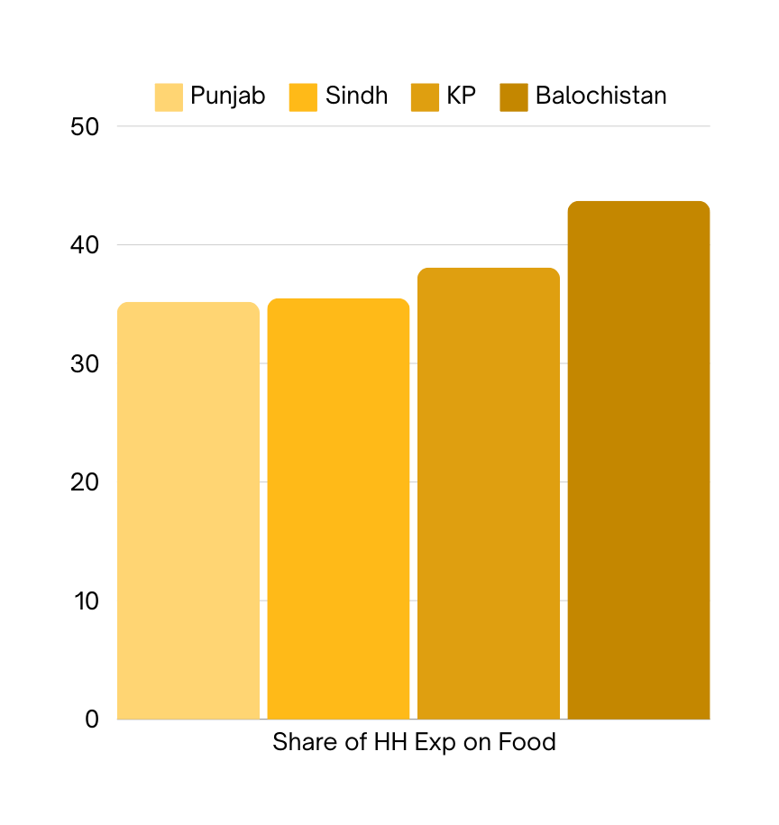

Provinces
Monthly Household Consumption Expenditure by quantiles
Share of Food Commodities (HEIS 2018-2019)
Total: 35.49%
BALOCHISTAN
Q1
Urban: 47.01% | Rural: 51.73% |
Total: 50.96
The share of expenditure on food commodities is highest in Balochistan, depicting high vulnerability to economic shocks in the province, with as far as half of the total HH expenditure in low income groups being spent on food alone.

Slide 11
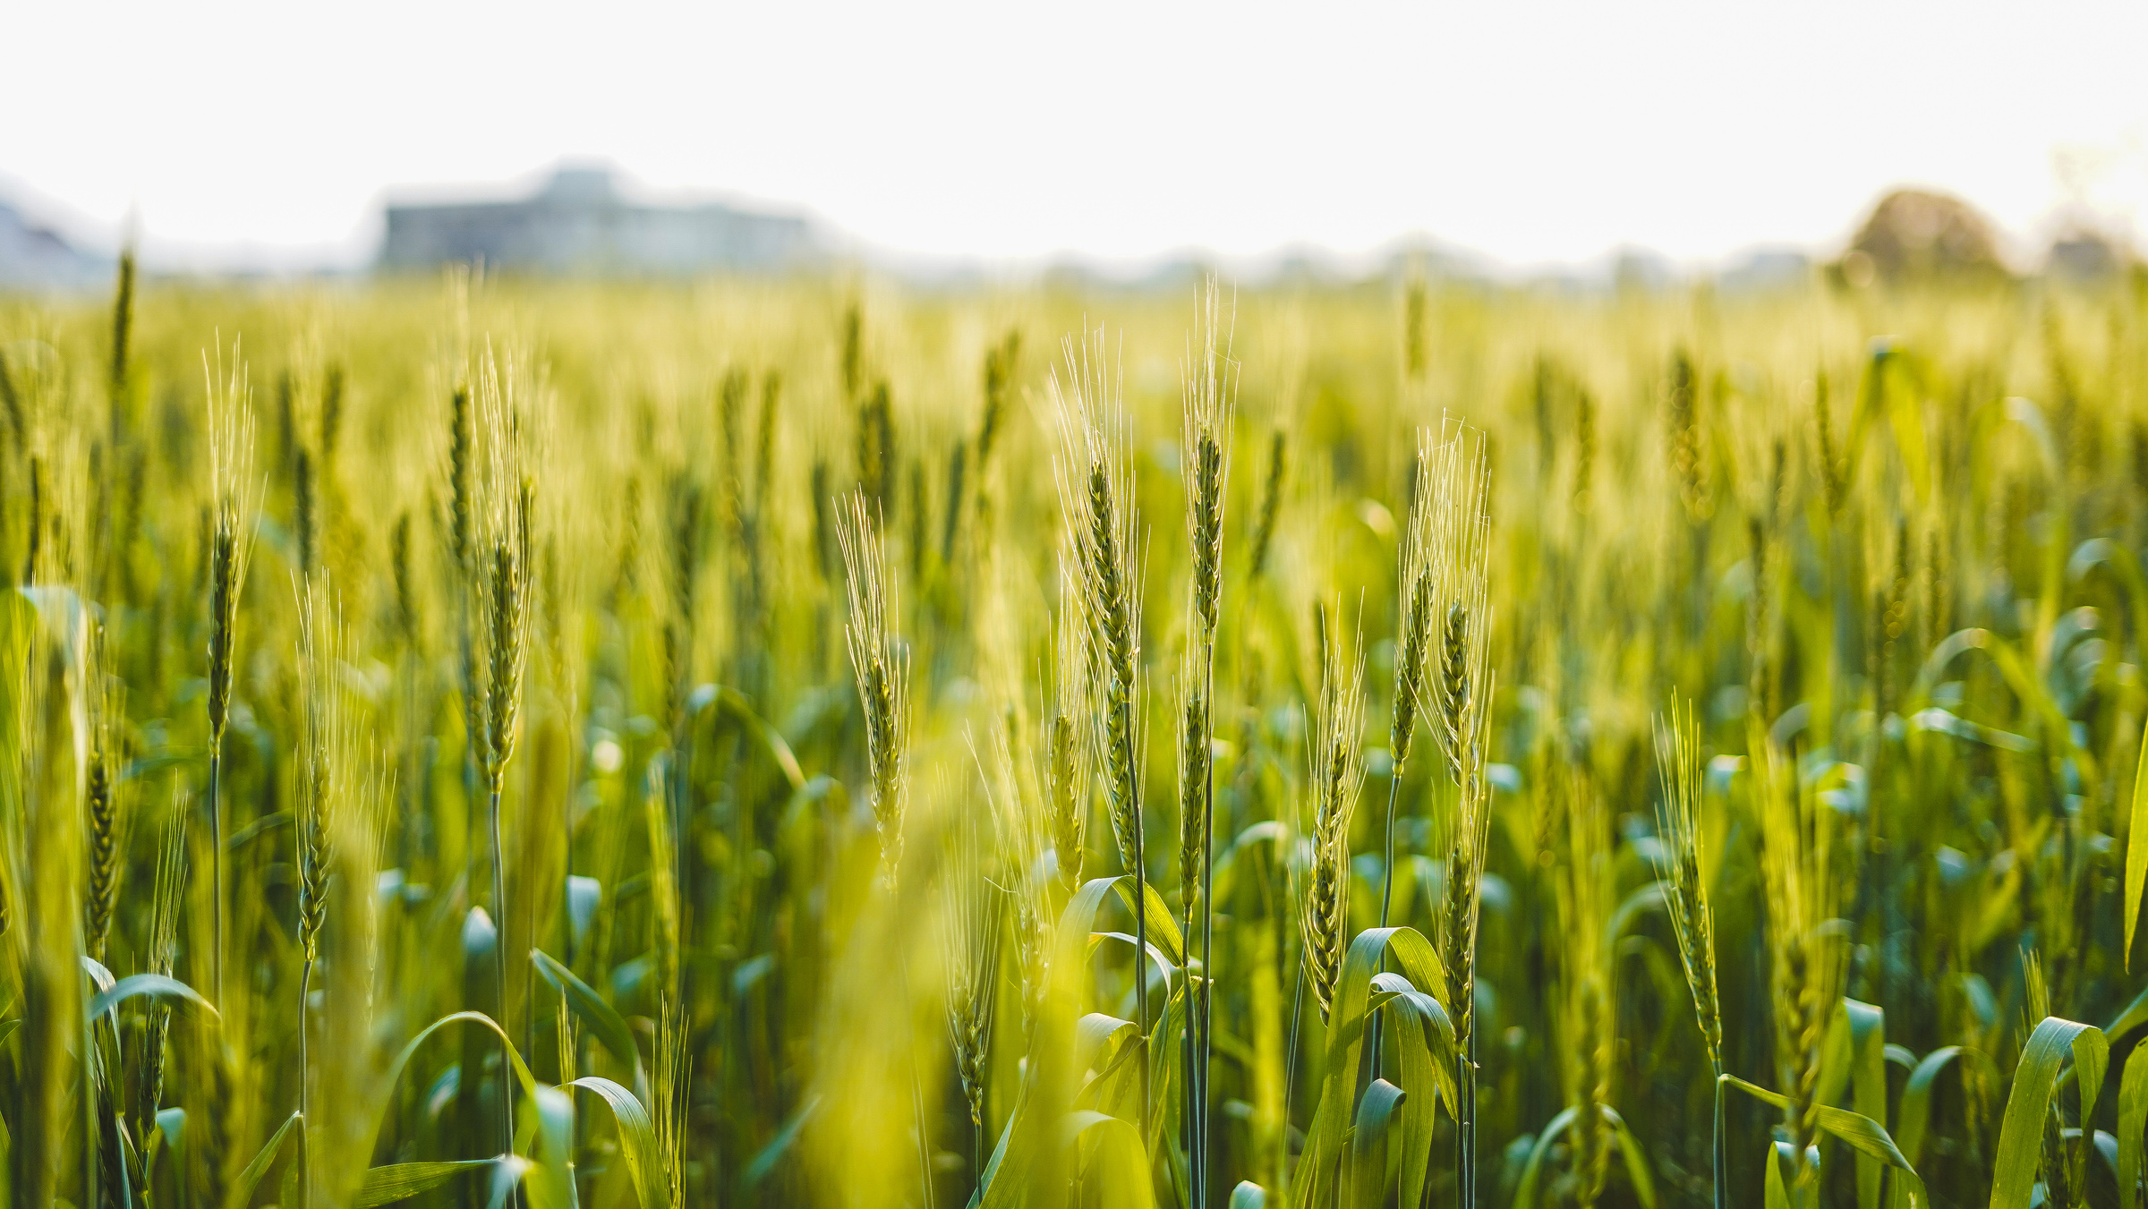
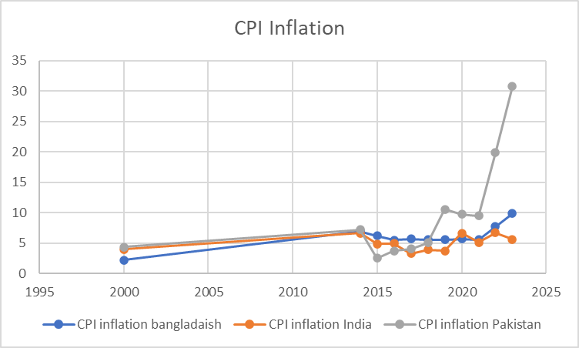
CPI Inflation (2000-2023)
Pakistan
India
Bangladesh
CPI inflation sky rocketed to above 30% in 2023
Inflation grew moderately from 4% in 2000 to 5.6% in 2023.
CPI inflation increased from 2.2% in 2000 to 9.9% in 2023

Slide 12
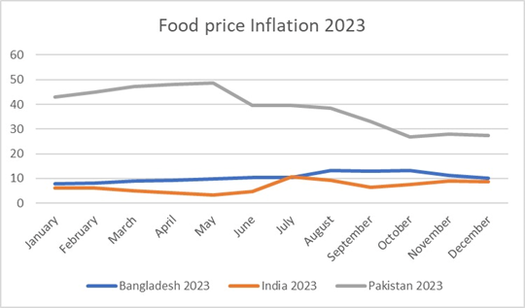
Food Price Inflation (2023)
Pakistan
Highest inflation rate, beginning at 42.9% in January, peaking at 48.7% in May, and steadily falling to 27.5% by December.
India
Reasonably constant in the first half of the year, with a low of 3.3% in May, peaking at 10.6% in July and reducing to 8.6% in December.
Bangladesh
Food prices rose steadily, beginning at 7.8% in January and peaking at 13.1%, reducing to 10.1% by December
Source: FAOSTAT

Slide 13
Financialization and Efficiency is being employed in the service of productionism in Wheat, reducing the value capture by farmer and end consumer, resulting food insecurity due to affordability
Website

Slide 14
Key Terms
Modernity Paradox
Efficiency Traps
Productivism
Post-productivism
Social market economy
Nationalist social economy
Ecological Modernization of agriculture and Green Industrialization
Capitalist Operations
Financialization
Feedback shut-down buttons
Easy Rescue

Slide 15
Hypothesis
Wheat is the latest target of a capitalist operation, with financialization as the major mechanism in the name of efficiency.
Financialization can takes a perverse form, depending on the nature of the drivers that facilitate the financialization and its diffusion. There is a need of a new consensus on the [1] nature of unique internal challenges faced by the social world of wheat in Pakistan, [2] nature of combined, effects of financialization, digitalization and globalization, [3] nature of ‘real’ Green Revolution that Pakistan needs and [4] nature of Social Politics needed to restore value to the lands and people of Pakistan.

Slide 16
Financialization of Wheat Market
Drivers of Financialization
Speculative investment
Market Efficiency
Drivers of Financialization
Globalisation
Pice Gouging
Digitalization in agriculture

Slide 17
Speculative investments in grains
Financialization of agricultural products by speculative investments in key commodities
Channels of Speculations
Using financial instruments, e.g. buy inventories or surplus stocks and hoard.
Buy the crops through advance payments
Global grain market is undergoing changes with global food corporations' re-organisation of agri-food chains for profits.
The increased influence of finance in the agri-food systems allows profit-making by investors and private equity consortia.
Massive financialization of food and subsequent profiteering could become lucrative pathways to wealth accumulation from food businesses which has serious implications for small farmers, consumers, food security, food prices, and farmers’ general social well-being.
Notes:
https://www.foodsystemsdashboard.org/

Slide 18

Digitalization in food and agriculture
Digital technology use in the entire food chain strengthens the retail sector’s global commodity chains
Introducing additional layers of control and value extraction by corporations utilizing the power of data
Corporations are using advertisements to blur the distinction between social markets and induced markets.
Research shows that using the power of technology and information, corporations leverage different compliances, resulting in taking over the regulatory space of government for food quality standards enforcement.
Fintech and widespread information and communication tools are not yet helping develop reliable pro-farmer or pro-consumer coalitions.
Profit gouging and excessive value capture by the corporation could be possibly increasing in the Biscuit Industry of Pakistan
Notes:
https://www.foodsystemsdashboard.org/

Slide 19
Globalization in food and agriculture
Food Insecurity and Internationalization: Recent food insecurity concerns in the North, triggered by the Ukraine crisis, have led to a renewed focus on internationalizing food systems.
Impact on Global South: This shift may exacerbate food insecurity in Global South countries, especially those grappling with debt stress and weak currencies reliant on energy and food imports.
Impact on Pakistan: They would like to peg the local wheat prices with the international prices adding the third dimension to the mix i.e., financialization, digitalization and internationalization.
Impact on agriculture: Financialization promotes monoculture farming as a small set of staple crops are grown to reduce investment risk, which has implications for the diversity of agricultural production and food security
Notes:
https://www.foodsystemsdashboard.org/

Slide 20
Reconceptualizing the Social World of Wheat as a critical policy & research agenda
Website

Slide 21
Production and exchange in rural Pakistan
Flux in Rural Society and Economy
The rural economy has grown big but the value distribution now has a totally different character
The rural household is under pressure to buy those services which were available to him before in kind by the state i.e., education and health.
The burden of crime and litigation has increased many folds resulting in mounting household debt, escalating economic subjugation.
The levels of household debts and the inability even of multiple jobs in creating a household break-even should have acted as ‘efficiency shutdown feedbacks’ i.e. to move away from the current practice of financialization agricultural production and exchange.
The post-productivist model adopted in Pakistan has changed the value of agri-land, which requires high MSP even for the staple food
The land is being used for recreation and non-food production eg country homes, housing colonies, theme parks, modern business offices, not-much sports, cultural, communal, art places
With cash crops doing well, connectivity improving a lot, a market civilization with uniform habits of fun consumption, the rural economy is now in the process of being highly servitized
Notes:
https://www.foodsystemsdashboard.org/

Slide 22
Production and exchange of Wheat and wheat products in Pakistan
What shape has post-productivism adopted in Pakistan?
In Pakistan we do not have the romantic post-productionism leading to an ecological modernization
Ideally, the post-productionism suppresses the excesses of producing for the sake of profit denuding the sustenance capacity of land
Very few local cooperative solutions emerging to improve the localized food insecurity
Value of land as a socioeconomic asset is diminishing, paving the way for the corporate landgrab.
We are witnessing the phenomenon of gentrification of rural land for holiday homes, recreational purposes etc.
The social world of wheat as land-based sustenance life in the countryside is losing to fast-paced financialized exchanges, making the households with limited assets very vulnerable
The financialization of land and staple would end any semblance of social harmony in the country-side.
Notes:
https://www.foodsystemsdashboard.org/

Slide 23
Production and exchange of Wheat and wheat products in Pakistan
Implications of further liberalization and deregulation
Once the government allows the private sector to buy the surplus, the latter would change the notion of surplus. They would define the surplus of wheat in April and instead of carrying the stock to next year they would like to export or sell it multiple times in a hoarding-leveraging-smuggling context.
Further dollarization of the wheat economy.
In other words, once they monopolize the benefits, the losses could be socialized through inflation and government subsidies, including BISP transfers.
The farmer and the end consumer is dehumanized, being deprived of any agency, any real bargaining.
A weakening social market economy in staple food eats up social harmony.
If we do not shutdown the efficiency button despite the severe food insecurity, we risk serious social unrest in Pakistan.
Notes:
https://www.foodsystemsdashboard.org/

Slide 24
Conclusion
A large part of food inflation is manufactured with a view to capture value in wheat in the form of financial rents.
A successful capitalist operation in staple food would push Pakistan to the stage of hyper-capitalism.
Robustness of a social market economy is measured in its capacity to save the value produced by a small economic actor from predators.
The global experience tells us that the financialization of staple food liquifies the life of the farmer’s household.
The new poverty staring us in the face of further liberalization of wheat could be significantly reduced if we resocialize the three public services i.e., production of staple food, health and criminal justice.
It is hard to practice a genuine post-productivism in Pakistan without ushering ourselves conceptually in a post-efficiency era in a framework of Green Industrialization, making green a moral imperative .
Notes:
https://www.foodsystemsdashboard.org/

