Slide 1
Services Sector Development
Dr. Safdar A. Sohail
Executive Director, Social Policy Resource Centre, Islamabad
[Former Special Secretary Cabinet, govt. of Pakistan, Islamabad & Dean, National School of Public Policy, Lahore
NIPA Peshawar; 04.08.2025

Slide 2
PART ONE
EVOLUTION OF THE SERVICES SECTOR : DISTINGUISHING BETWEEN SERVICES AND SERVITIZATION

Slide 3
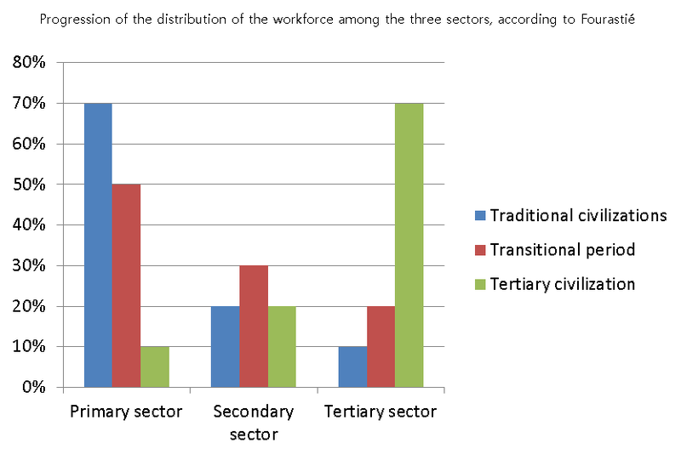
Notes:
Pre-War, Post War; 21st CenturyReference: https://en.wikipedia.org/wiki/Three-sector_theory#/media/File:The_distribution_of_the_workforce_among_the_three_sectors.png

Slide 4
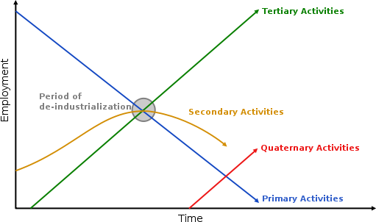
‘Normal’ process of de-industrialization
Notes:
Reference:https://upload.wikimedia.org/wikipedia/commons/thumb/a/af/Clark%27s_sector_model.svg/511px-Clark%27s_sector_model.svg.png

Slide 5
5 Sectors of Economy by activity: More of an academic and public policy convenience?
Primary Sector: Extracting and obtaining natural resources, including activities like agriculture, fishing, mining, and forestry.
Secondary Sector: Manufacturing and processing raw materials into finished goods, such as factories, construction, and utilities. Thrust back into the heart of the economy by Western drive to reindustrialize
Tertiary Sector: Provision of services, including retail, healthcare, education, transportation, and finance.
Quaternary Sector: Dealing with knowledge-based activities, including research and development, information technology, and consulting.
Fifth Sector: Focuses on the creative and digital economy, including innovation, capital projects, skills development, and digital connectivity.

Slide 6
Modes of International Trade in Services
Mode I
Across the border e.g., Tele-medicine; software solution; Electronically Transmitted Products
Mode II
Consumption Abroad: Tourism; Foreign Studies
Mode III
Commercial Presence Abroad: FDI
Mode IV
Movement of Natural Persons

Slide 7
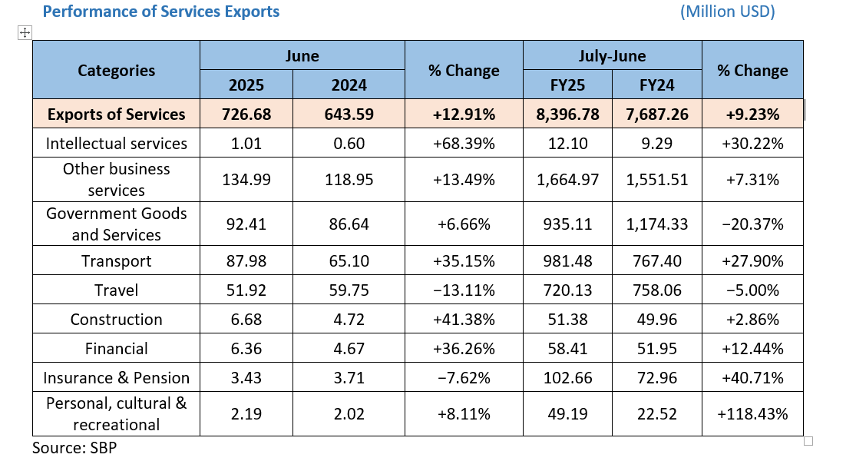

Slide 8
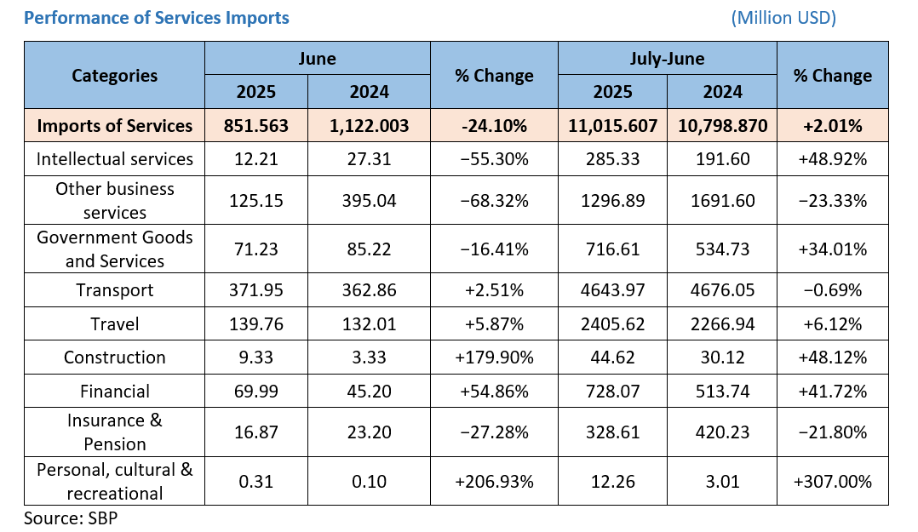

Slide 9
Sectoral Share in GDP Pakistan Economic Survey; 2024-25

Slide 12
Drivers of the increasing services sector contribution in Pakistan: Traditional
Expansion of logistics, connectivity, business, financial and network services
Private consumption/remittances
Government expenditure’s effect on social and infrastructure development
Urbanization & population growth
Foreign direct investment
Self-employment in services
Trade in services

Slide 13
Drivers of service sectors contribution in Pakistan: Non-Traditional
Privatization, financialization of basic public services and utilities
Digital Transformation
Global Integration of some sectors
Global Service Systems and differential integration
Wealth and social media driven consumption as a mega trend in Pakistani society

Slide 14
Policy Challenges
Managing [correctly] the liberalization of Services as a part of Market Deregulation after Trade Liberalization
Co-creation of Value in an emerging consumption system marked by ‘service dominant logic’ resulting in induced markets
Globalization of Services-heavy consumption systems becoming a major source of Value loss to foreign brands
Services as vectors of financialization and dollarization of life and society in developing countries [Market Civilization]
Domination in the global supply of services as a major contestation impacting the economic and cultural sovereignty of Global South

Slide 15
Future Challenge: Unresolved tension between Accumulation Regime and Regulation Regime
A weak Social Market Economy was transformed into Hyper-capitalism Economy from late 1990s
‘Regulatory State’ disconnected the developmental state from Social Market Economy.
The speed of controlling developmental state’s development and facilitation resources increased with the primacy accorded to private sector
As the regulatory regimes do not produce results in the presence of weak institutions afflicted with weak regulatory capacity, limited commitment, little accountability and limited fiscal efficiency, a new state system has emerged with an advanced stage of capture of both development resources and regulatory regime creating poverty and inequality systematically.

Slide 16
Part 2
Services sector as a bridge between hyper-capitalism and social [market] economy?
Social and Solidarity Economy
Prioritizing people and the planet over profit by adopting reciprocity as a driving force, re-embedding economy in society, and undoing fictitious commodities

Slide 17
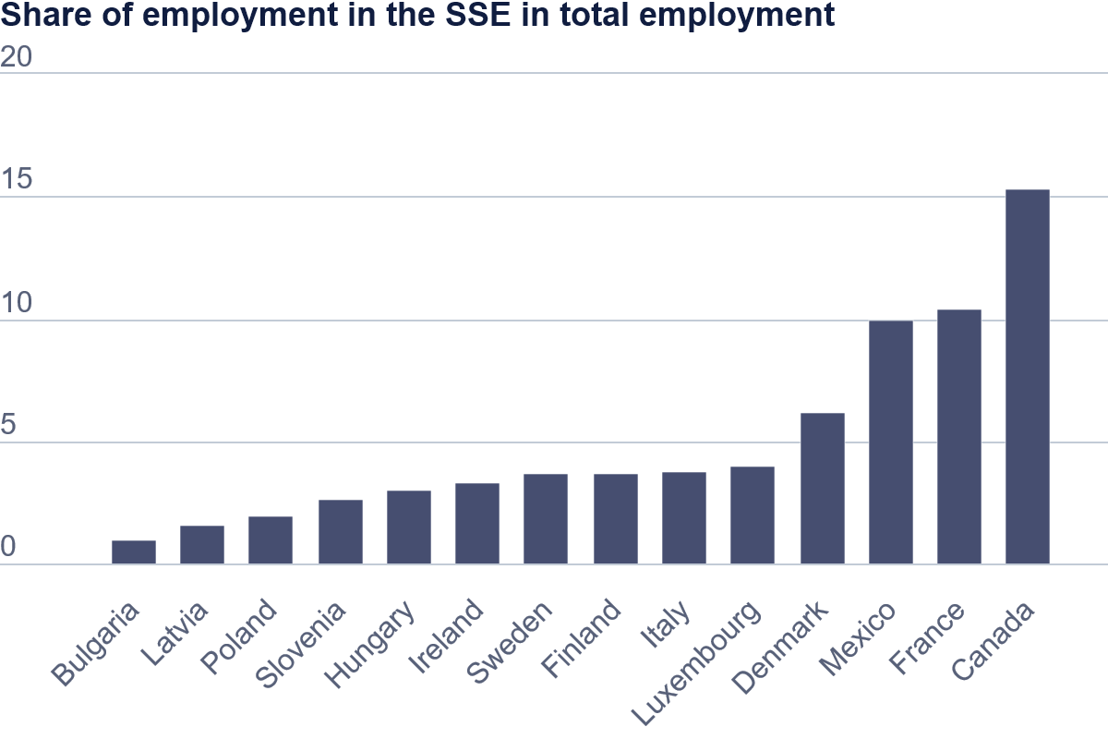

Slide 18
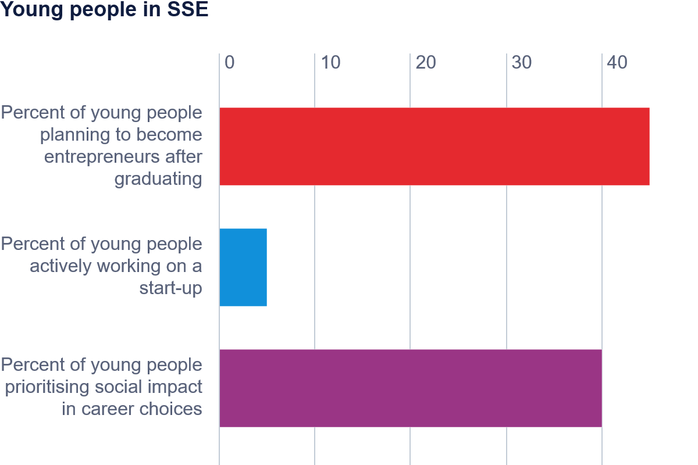

Slide 19
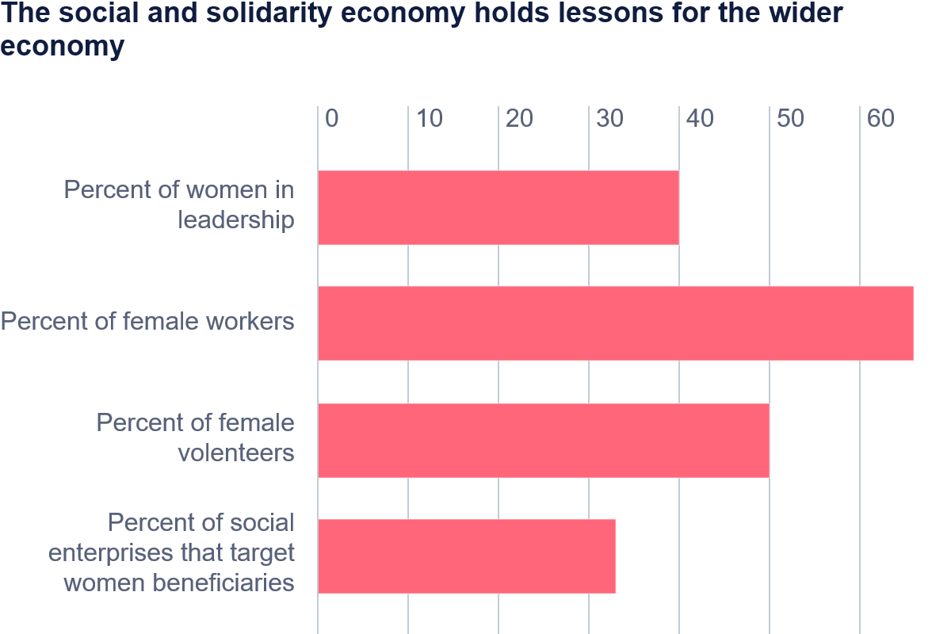

Slide 20
Way forward: Curbing profit-motive in Services Sector and promoting SSE in Pakistan
The case of Disability care
Ideally, to serve 40, 000 households hosting severe disability and 20 residential care facilities, you need Rs. One billion financing. This One Billion would produce 10,000 direct care giver jobs, 1000 indirect jobs, would release 25 thousand persons to become productively employed and enhance the overall productivity of the economy.
At present, the financing care of 50 K households hosting disability is less than Rs. 10 million with hardly 200 jobs
It requires compassion and clear-headedness on the role Social and solidarity economy in lifting economy and society together. But what do you do of the Fifth Sector?

Slide 21
IMF and the future of increasingly servitized Pakistan Society: Hollowing out the social contract
Impact of IMF Agenda on the developmental role of Services Sector
Strengthening Public Finances [Austerity]
Restoring the Energy Sector's Viability [Further Deregulation]
Returning Inflation to Target [Contraction of economy]
Promoting Private-Led Activity [Wheat]
Social Protection and Poverty Reduction [Politicization of Income Transfers]
Strengthening Governance [Old medicines]
State-Owned Enterprise (SOE) Reforms [Throwing Baby with Bath Tub]
Market-Based Currency Exchange Rate [Forex black market and dollarization]

